Slide 1
Unit VII(7) Essays
Prompts to help you guide your thinking for the Unit 7 Essay Test.

Slide 2
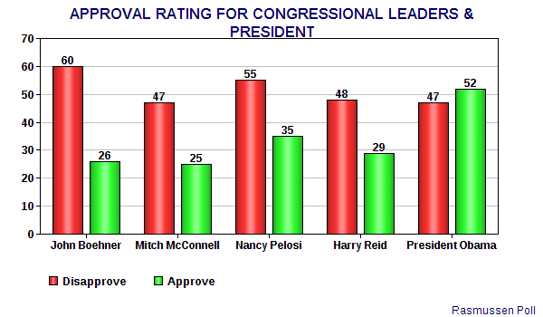
Idea 1
In Congress does the will of the people always prevail or get considered?
Use relevant articles from class and current events and your textbook to support your answer(s)
A thesis is strongly recommended here.
A conclusion is recommended too ☺

Slide 3
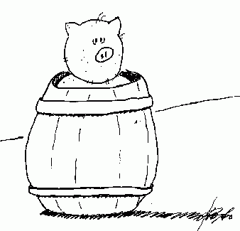
Prompt/Idea 2
Analyze/Interpret the attitudes people have towards Congress and their individual Congressional Representative.
What accounts for the potential differences in attitudes?
Feel free to tie in relevant info from your textbook or articles you read in class.
Hint: We hate Congress but love our Congressman/woman? Why?

